Slide 1
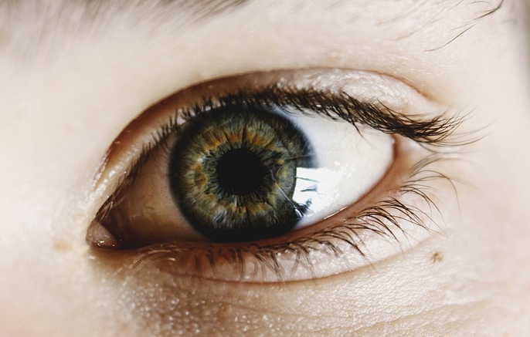
My eye
We use our eyes to see.
The black dot in the middle is called a pupil.
Notes:
Photograph: CCO Creative Commons pixabay

Slide 2
My eye
Which part(s) of our eye can detect the light we see?
The pupil is a hole light can go through
The pupil can detect light
The back of the eye can detect light

